Slide 1

agile Roles

Slide 2

To understand the roles people take in an Agile Project
Objectives
Stakeholder
Project manager
Product Owner
Business Analyst
Scrum Master
Development Team

Slide 3
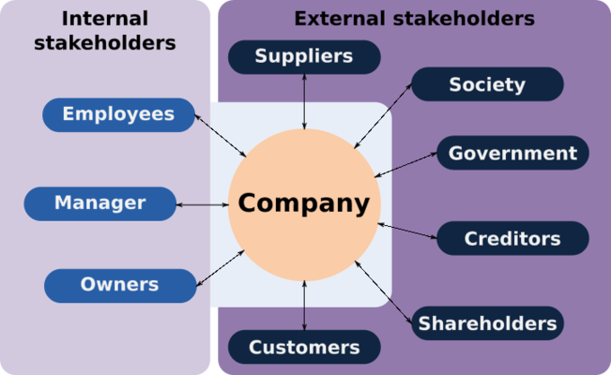
A stakeholder is anyone with an interest in or an influence on the product.
Should be contactable by the development team to help them to understand what is required.
They should attend the Sprint review meeting
The stakeholder
This Photo by Unknown Author is licensed under CC BY-SA

Slide 4
PO is the sole person responsible for managing the product backlog (list of features to be worked on).
They communicate with the stakeholders to ensure requiremnets are added to the product backlog
They attend the Sprint planning meeting and Sprint review meeting
Product Owner

Slide 5







Works with company Chief
Customer support
Users and customers
Product Manager
Scrum Master
Development team
Marketing and sales
More about the Product owner
1. Defining the vision
2. Product backlog management
3. Prioritizing needs
4. Overseeing development stages
5. Anticipating client needs
7. Evaluating product progress at each iteration

Slide 6

Manage projects and will overview expenses.
Try to reduce risk on the project.
Can also manage more than one project at a time.
Project Manager

Slide 7

Supports the product owner by gathering requirements and providing guidance on what to build.
They usually work across many products.
Business Analyst (BA)
This Photo by Unknown Author is licensed under CC BY

Slide 8
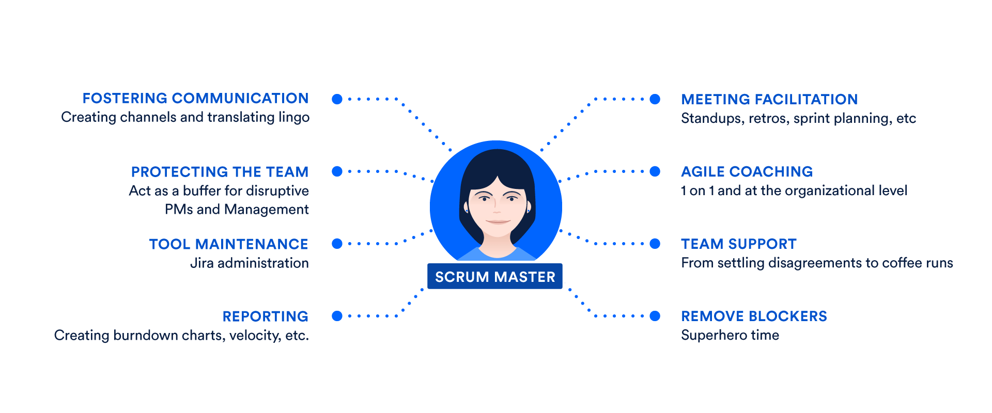
Helps those outside the scrum team understand which interactions are beneficial.
Help find techniques with effective Product Goal definition and Product Backlog management
Scrum master (SM)
Supports the development team by removing impediments, facilitating meetings and coaching self-organisation
Attends the Sprint planning, Daily stand up, Sprint review
and the Sprint Retrospective meetings
https://www.atlassian.com/agile/scrum/scrum-master

Slide 9
A multi-disciplinary development team usually consists of software architects, designers, programmers and testers.
This is a self organising team. They decide how to tackle the items in the sprint backlog.
People with other skillsets can be added to the team when required.
Attend the Sprint planning, Daily stand up, Sprint review and the Sprint Retrospective meetings
DEVELOPMENT TEAM

Slide 10

You now understand the following roles within an Agile project
Review
Stakeholder
Project manager
Product Owner
Business Analyst
Scrum Master
Development Team

Slide 11
Lab
Complete Lab4.
Duration 20 minutes

